Slide 1
Pointers
These are the variables that are used to hold the address of another variable

Slide 2
Pointer variable
A pointer is a variable that contains the memory location of another variable.
Syntax:-
type * variable name
You start by specifying the type of data stored in the location identified by the pointer.
The asterisk tells the compiler that you are creating a pointer variable.
Finally you give the name of the variable.

Slide 3
Declaration and Initialization
Syntax for declaring pointer is
data_type * ptr variable name;
Example : int *p;
Syntax for Initialization of a pointer is
ptr var name= & var name;
Example : p=&a;

Slide 4
Declaring a Pointer Variable
To declare ptr as an integer pointer:
  int *ptr;
To declare ptr as a character pointer:
  char *ptr;

Slide 5
Address operator:
Once we declare a pointer variable we must point it to something we can do this by assigning to the pointer the address of the variable you want to point as in the following example:
ptr=&num;
This places the address where num is stores into the variable ptr. If num is stored in memory 21260 address then the variable ptr has the value 21260.

Slide 6
Address and Pointers
Memory can be conceptualized as a linear set of data locations.
Variables reference the contents of a locations
Pointers have a value of the address of a given location
ADDR1
Contents1
ADDR2
ADDR3
ADDR4
ADDR5
ADDR6
*
*
*
ADDR11
Contents11
*
*
ADDR16
Contents16
Lect 14 P. <number>
Notes:
Engineering H192
Winter 2005
Lecture 14

Slide 7
Pointer Variable
Assume ptr is a pointer variable and x is an integer variable
x
10
ptr
&x
Now ptr can access the value of x.
HOW!!!!
Write: *variable . For example:
Cout<< *ptr;
x = 10
ptr = &x

Slide 8
Program to display variable value and address value
Void main ()
{
int *p,a;
Clrscr();
Cout<<“enter the value of a”;
Cin>>a;
p=&a;
Cout<<“address of variable a using pointer is”<<p;
Cout<< value of variable a using pointer is”<<*p;
getch();
}
// variable address= p
// variable value=*p

Slide 9
Another Program
int a=20;
int *p;
p=&a;
Cout<<a<<&a;
Cout<<p<<&p<<*p;
P has an address 500

Slide 10
Variables, Addresses and Pointers
main()
{
int a = 5;
int b = 6;
int *c;
// c points to a
c = &a;
}
Memory Value
a (1001) 5
b (1003) 6
c (1005) 1001

Slide 11
include< stdio.h >
{
int num, *intptr;
float x, *floptr;
char ch, *cptr;
num=123;
x=12.34;
ch=’a’;
intptr=&num;
cptr=&ch;
floptr=&x;
cout<<“Num “<<*intptr,<<“ stored at address “<<intptr;
cout<<“Value “<<*floptr <<“ stored at address “<<floptr;
cout<<“Character <<*cptr <<“stored at address”<<cptr;
}

Slide 12
Pointer to pointer
Pointer variable that holds the address of another pointer
Declaration :
int **p1,*p;
Initialization
p1=&p;

Slide 13
Pointers to pointers
A pointer variable containing address of another pointer variable is called pointer to pointer
void main()
{
int a=2, *p, **q;
p=&a;
q=&p;
cout<<a<<“is stored at ”<<p<<“and pointer is stored at ”<<q;}

Slide 14
Pointer arithmetic
Valid operations on pointers include:
- the sum of a pointer and an integer
- the difference of a pointer and an integer
- pointer comparison
the difference of two pointers.
Increment/decrement in pointers
assignment operator used in pointers

Slide 15
Pointer Arithmetic
Operations on pointer variables:
Operation | Example int vals[]={4,7,11}; int *valptr = vals;
++, -- | valptr++; // points at 7 valptr--; // now points at 4
+, - (pointer and int) | cout << *(valptr + 2); // 11
+=,-= (pointer and int) | valptr = vals; // points at 4 valptr += 2; // points at 11
CIS 15 Pointer Arithmetic

Slide 16
Pointer Arithmetic
Void main()
{
Int *p,a,**p1;
Clrscr();
Cout<<“Enter the value of a”;
Cin>>a;
p=&a;
p1=&p;
Cout<<“address of variable a using ptr”<<p;
p=p+4;
Cout<<“modified address is”<<p;
Cout<<“value of variable a using ptr is”<<*p;
*p=*p+20;
Cout<<“modified value of variable a is ”<<*p;
Cout<<“address of pointer p is”<<p1;
getch();}

Slide 17
Pointer Arithmetic
void main()
{
int a=25,b=78,sum;
int *x,*y;
x=&a;
y=&b;
sum= *x + *y;
cout<<“Sum is : ”<<sum;
}

Slide 18
Assignment in pointers
Pointer variables can be "assigned":
int *p1, *p2;
p2 = p1;
  Assigns one pointer to another
  "Make p2 point to where p1 points"
Do not confuse with:
*p1 = *p2;
  Assigns "value pointed to" by p1, to "value
  pointed to" by p2

Slide 19
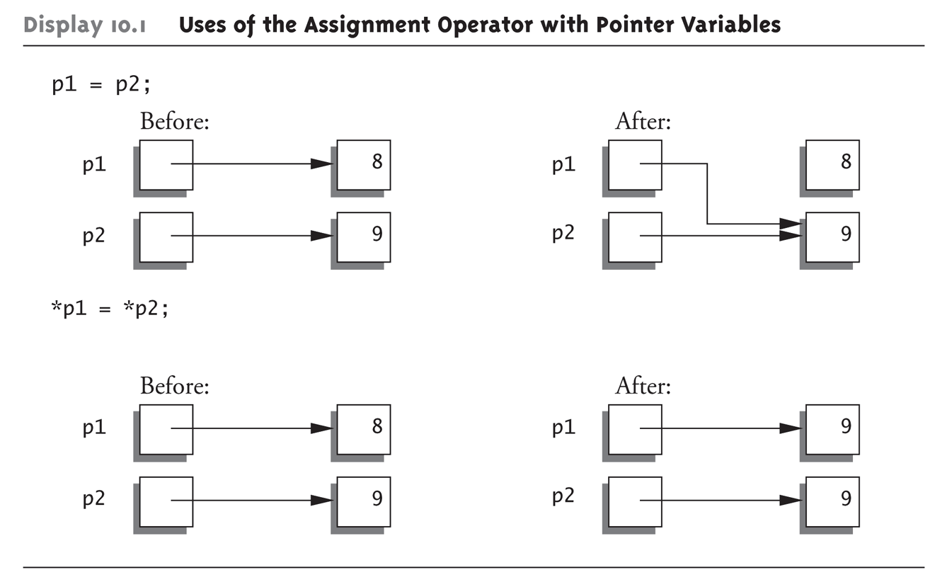
Diagrammatic representation

Slide 20
Comparison in pointers
Two pointers of the same type, p and q, may be compared as long
as both of them point to objects within a single memory block
• Pointers may be compared using the <, >, <=, >=, == , !=
• When you are comparing two pointers, you are comparing the
values of those pointers rather than the contents of memory locations pointed to by these pointers

Slide 21
Reference
Reference &
Retrieve the memory address of a variable
int a = 6;
int* c = &a; // &a is the memory location of variable a

Slide 22
Dereference
Dereference * Accessing the variable (content) the pointer points to
(Indirection)
int a = 6;
int* c = &a;
*c = 7; /* Changes content of variable a by using its address stored in pointer c */
equivalent to
a = 7;

Slide 23
Run this code
int main()
{
int x;
int *ptr;
x = 10;
ptr = &x;
*ptr = *ptr + 1;
cout<< x;
return 0;
}

Slide 24
Generic pointers
When a variable is declared as being a pointer to type void it is known as a generic pointer.
Since you cannot have a variable of type void, the pointer will not point to any data and therefore cannot be dereferenced.
It is still a pointer though, to use it you just have to typecast it to another kind of pointer first. Hence the term Generic pointer.

Slide 25
This is very useful when you want a pointer to point to data of different types at different times.
Syntax:
  void * variable name;
  Print value stored in variable
  *(data_type*)name of variable;

Slide 26
    void main()
    { int i;
    char c;
    void *data;
    i = 6;
    c = 'a';
    data = &i;
    cout<<"the_data points to the integer value “<< *(int*) data;
    data = &c;
    cout<<"the_data now points to the character “<< *(char*) data;
    }

Slide 27
Void Pointer
It is called the Generic pointer
It is a special type of pointer that can be pointed at objects of any data type
A void pointer is declared like a normal pointer, using the void keyword as the pointer’s type
Example: void *pVoid; // pVoid is a void pointer

Slide 28
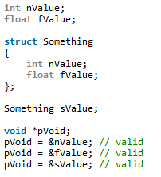
Void Pointer (Contd)
A void pointer can point to objects of any data type
Example:

Slide 29
Other Properties of Void Pointer
It Can’t be Dereferenced because void pointer does not know what type of object it is pointing to.
It is not possible to do pointer arithmetic on a void pointer.
Since void pointers can’t be dereferenced, there is no such thing as a void reference

Slide 30
Null Pointer
A null pointer is generally used to signify that a pointer does not point to any object
NULL pointer is a type of pointer of any data type and generally takes a value as zero. This is, however, not mandatory. This denotes that NULL pointer does not point to any valid memory address.

Slide 31
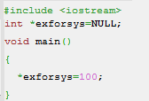
Example of Null Pointer
int* exforsys;
exforsys=0;
The above statement denotes exforsys as an integer pointer type that does not point to a valid memory address. This shows that exforsys has a NULL pointer value.

Slide 32
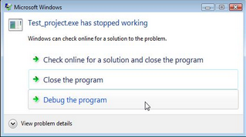
Output of the Program
The output will result in Run Time Error. This means that the pointer variable exforsys is not assigned any valid address and, therefore, attempting to access the address 0 gives the above error message.

Slide 33
Null Pointer (Contd.)
NULL value can be assigned to any pointer, no matter what its type.
void *p = NULL;
int i = 2;
int *ip = &i;
p = ip;
cout<<*p;
Output=2

Slide 34
Difference between Null Pointer and Void Pointer
A Void pointer is a special type of pointer of void and denotes that it can point to any data type.
NULL pointers can take any pointer type, but do not point to any valid reference or memory address

Slide 35
Dangling Pointers
Points to Invalid Location
Dangling pointers arise when an object is deleted or de allocated, without modifying the value of the pointer, so that the pointer still points to the memory location of the de allocated memory.

Slide 36
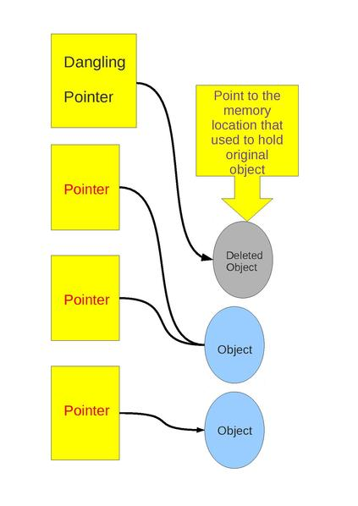
Dangling Pointer

Slide 37
Difference between dangling Pointer and Null Pointer
NULL pointer points to nothing. But dangling pointers are those pointers which points to invalid location (e.g. still points to those memory locations which are already freed)
int *p = NULL;
Is mere a pointer which is not initialised to valid memory location. it points to nothing int *q ; q -> 0x1Ax

Slide 38
Null Pointer
NULL value can be assigned to any pointer, no matter what its type.
void *p = NULL;
int i = 2;
int *ip = &i;
p = ip;
cout<<*p;
cout<<*((int*)p ) ;
Output=2

Slide 39
Wild pointer
Every pointer when it is not initialized is defined as a wild pointer.
As pointer get initialized, start pointing to some variable its defined as pointer not a wild one.

Slide 40
Constant Pointers
A constant pointer, ptr, is a pointer that is initialized with an address, and cannot point to anything else.
We can use ptr to change the contents of value
Example
int value = 22;
int * const ptr = &value;
CIS 15 Pointer Arithmetic

Slide 41
Constant Pointer
Constant pointer means the pointer is constant. Constant pointer is NOT pointer to constant.
For eg:
int * const ptr2 indicates that ptr2 is a pointer which is constant. This means that ptr2 cannot be made to point to another integer.
However the integer pointed by ptr2 can be changed.

Slide 42
    //const pointer void
    main()
    {
    int i = 100,k;
    int* const pi = &i;
    *pi = 200;
    pi=&k; //won't compile
    }

Slide 43
Constant Pointers to Constants
A constant pointer to a constant is:
  a pointer that points to a constant
  a pointer that cannot point to anything except what it is pointing to
Example:
int value = 22;
const int * const ptr = &value;
CIS 15 Pointer Arithmetic

Slide 44
Pointer to constant
Pointer to constant is
const int * ptr1 indicates that ptr1 is a pointer that points to a constant integer. The integer is constant and cannot be changed. However, the pointer ptr1 can be made to point to some other integer.

Slide 45
//pointer to a const
void f1()
{
int i = 100;
const int* pi = &i;
//*pi = 200; <- won't compile
pi++;
}m

Slide 46
Pointers and Arrays
The concept of array is very much bound to the one of pointer. In fact, the identifier of an array is equivalent to the address of its first element, as a pointer is equivalent to the address of the first element that it points to, so in fact they are the same concept.

Slide 47
Pointers and Arrays
Pointers have close relationship with array .
An array name by itself is an address or pointer.
Pointers are linked with both types of array
  A)one dimensional array pointer
  B)two dimensional array pointer

Slide 48
For example,
int numbers [20]; int * p;
The following assignment operation would be valid:
p = numbers;

Slide 49
After that, p and numbers would be equivalent and would have the same properties. The only difference is that we could change the value of pointer p by another one, whereas numbers will always point to the first of the 20 elements of type int with which it was defined. Therefore, unlike p, which is an ordinary pointer, numbers is an array, and an array can be considered a constant pointer.

Slide 50
int numbers[5];
int *p;
p = numbers;
*p = 10;
p++;
*p = 20;
p = &numbers[2];
*p = 30;
p = numbers + 3;
*p = 40;
p = numbers;
*(p+4) = 50;
for (int n=0; n<5; n++)
cout<<numbers[n];
Cont…

Slide 51
In arrays we used brackets ([]) several times in order to specify the index of an element of the array to which we wanted to refer. Well, these bracket sign operators [] are also a dereference operator known as offset operator. They dereference the variable they follow just as * does, but they also add the number between brackets to the address being dereferenced

Slide 52
For example:
a[5] = 0; // a [offset of 5] = 0
*(a+5) = 0; // pointed by (a+5) = 0
These two expressions are equivalent and valid both if a is a pointer or if a is an array.

Slide 53
Example of 1D array
  Void main()
  {
  int a[5]={1,2,3,4,5};
  int *p,i;
  p=&a;
  cout<<“displaying data using pointer ”;
  for(i=0;i<5;i++)
  {
  cout<<*(p+i);
  }
  cout<<“displaying data using array name ”;
  for(i=0;i<5;i++)
  {
  cout<<*(a+i);
  }
  }1,2,3,4,5
  1,2,3,4,5,

Slide 54
Pointers and Character String
        void main()
        main()
        {
        char name[] = "simran";
        char *ptr;
        int i=0,count=0;
        ptr=&name[0];
        while(*(ptr+i)!='\0')
        {
        count++;
        i++;
        }
        cout<<"length of string is "<<count;

Slide 55
Example
#include<conio.h>
main()
{
char str1[]="hello";
char str2[10];
char *s= "Good Morning";
char *q;
while(*s !='\0')
{
//str2=str1; //error/
*q= *s; //works/
s++;
cout<<*q;
}

Slide 56
Difference between *p[3] and (*p)[3]
*p[3] declares p as an array of 3 pointers
(*p)[3] declares p as a pointer to an array of 3 elements

Slide 57
Reference Variables
Reference variable = alias for another variable
- Contains the address of a variable (like a pointer)
- No need to perform any dereferencing (unlike a pointer)
- Must be initialized when it is declared
int x = 5;
int &z = x; // z is another name for x
int &y ; //Error: reference must be initialized
cout << x << endl; -> prints 5
cout << z << endl; -> prints 5
z = 9; // same as x = 9;
cout << x << endl; -> prints 9
cout << z << endl; -> prints 9

Slide 58
It provides an alias for a previously defined variable.
If we make the variable sum a reference to the variable total, then sum a reference to the variable total, then sum and total can be used interchangeably.
Datatype &r-name= v-name

Slide 59
It assigns additional meaning to symbol &. Here & is not an address operator. The notation float & means reference to float.
Float & sum =total
Int n[10];
Int &x=n[10];
Char &a=‘\n’;

Slide 60
A major application of reference variables is in passing arguments to functions.
Void f(int &x)
{
X=x+10;
}
Int main()
{
Int m=10;
F(m);

Slide 61
When function call f(m) executed,
Int & x=m;
Thus x becomes an alias of m after executing f(m);

Slide 62
Reference Variables
int a=5;
int *p;
p=&a;
Cout<<p<<*p<<&p;
Int &b=a;
a=a+2;
Cout<<b;
Mem,5,mem,7

Slide 63
Pointers to class members

Slide 64
Just like pointers to normal variables and functions, we can have pointers to class member functions and member variables.

Slide 65
Defining a pointer of class type
We can define pointer of class type, which can be used to point to class objects.

Slide 66
class Simple
{
public:
int a;
};
int main()
{
Simple obj;
Simple* ptr; // Pointer of class type
ptr = &obj;
cout << obj.a;
cout << ptr->a; // Accessing member with pointer
}
Here you can see that we have declared a pointer of class type which points to class's object. We can access data members and member functions using pointer name with arrow -> symbol.

